Slide 1


Welcome
26 September 2007
1st PRAGMA Institute
Notes:
Institute for Advanced Computing Applications and Technologies (IACAT)

Slide 2

Conceptual Framework for Building and Sustaining Community (e) Science
1st PRAGMA
Institute
Sustained
Collaboration
Previously
Unobtainable
Observations and
Understanding
Education
& Capacity
Building
Build teams and
trust
Develop human resources
Students and postdocs
Institutes and Training
Collab. framework
Many meetings
Science
Drivers
Enabling
Technology
Focus development
Advance science
Persistent
Infrastructure
Source, movement,
fate of carbon in lakes
Role of microbes in oceans
or human health
Active sites of infectious
agents
Streaming Data
Cross-site query
Mathematics
Workflow from Instr.
Dist. Files System
Collaborative Tools
Broaden impact
Software, data
Lambda Grids
Wireless sensor network
Notes:
Many more: Astronomy , Earthquake engineering, Biomedical informatics Research network

Slide 3
Grids are about People
Build the community of researchers in the Pacific Rim who use grid technologies by providing training opportunities

Slide 4
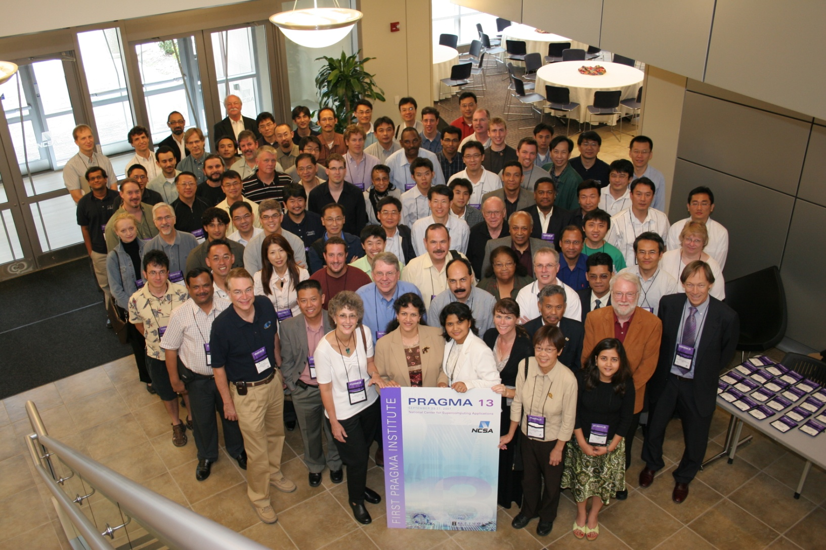
NCSA and IACAT, Thank you for hosting us

